Slide 1


Slide 2
Urinary complications in pregnancy
Dr.saedi
Assistant professor of Tehran university
Yas Hospital

Slide 3
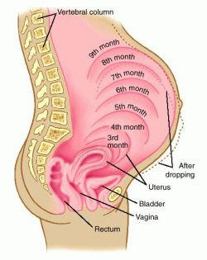
Frequency and nocturia
Frequency may be up to seven times or more of normal
slight nocturnal
The first trimester is the most common time of onset
The uterine weight is the most important factor also irritates the bladder
Normal bladder capacity in the first trimester is 410 ml
bladder capacity to 460 ml in the second trimester
Bladder capacity in the third trimester reduces to 272 ml

Slide 4
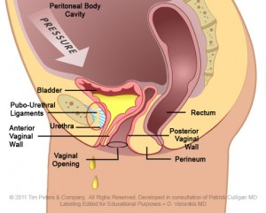
Urinary retention
Anatomical
Genital prolapse e.g., cystocele
Mass effect
Gynaecological tumors e.g., fibroids
Urological tumors
Faecal impaction and constipation
Urinary system obstruction e.g., impacted calculus in urethra,Pregnancy—incarcerated uteruscervical and tubal ectopic pregnancies
Blood clot in bladder
Urethral rupture
Bladder neck stenosis
Paraurethral abscess
Urethral stricture
Acute urinary retention in pregnancy: a case presentation and review of the literature Dushyant Maharaj & Malanie GajanayakaEur Clinics Obst Gynecol,

Slide 5

Drugs
Allergy or cold medications containing decongestants or antihistamines
Ipratropium bromide
Albuterol
Epinephrine
Opiates
Antimuscarinics
Αlpha adrenergic agonists
Antipsychotics
Acute urinary retention in pregnancy: a case presentation and review of the literature Dushyant Maharaj & Malanie GajanayakaEur Clinics Obst Gynecol

Slide 6
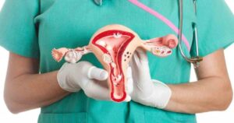
Surgery
Pain
Anesthesia related e.g., epidural/spinal anesthesia
Post-gynaecological/urological surgery e.g. incontinence procedures
Acute urinary retention in pregnancy: a case presentation and review of the literature Dushyant Maharaj & Malanie GajanayakaEur Clinics Obst Gynecol

Slide 7
Neurological
Cauda equina syndrome
Fowler’s syndrome
Spinal cord injury/nerve damage
Degenerative neurological disorders e.g., multiple sclerosis
Prolapse of invertebral disc
Acute urinary retention in pregnancy: a case presentation and review of the literature Dushyant Maharaj & Malanie GajanayakaEur Clinics Obst Gynecol

Slide 8
Infective
Urinary tract infection
Herpes genitalis
Herpes zoster
Acute urinary retention in pregnancy: a case presentation and review of the literature Dushyant Maharaj & Malanie GajanayakaEur Clinics Obst Gynecol

Slide 9
Miscellaneous
Hysteria and conversion psychologic disorder
Prolonged exposure to cold temperatures
Alcohol
Long period of inactivity or bed rest
Acute urinary retention in pregnancy: a case presentation and review of the literature Dushyant Maharaj & Malanie GajanayakaEur Clinics Obst Gynecol

Slide 10
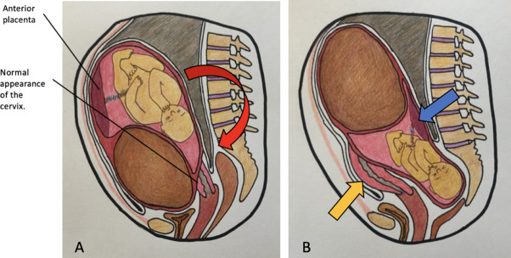
Incarcerated gravid uterus
Up to 20% of women have a retroverted uterus
Incarcerated gravid uterus is rare, occurring in 1 in 3000 to 10,000 pregnancies
Risk factors:
pelvic adhesions
uterine malformations
differing pelvic anatomical dimensions

Slide 11
Diagnosis
It typically presents 14-18 w
History
Ph/Ex
US
urinary retention or voiding difficulties
lower abdominal and back pain
possibly rectal pressure and constipation
difficult to palpate uterus
very anterior cervix
Elongated cervix in an anterior position
Uterine fundus seen in the hollow of the sacrum
Flat and long bladder

Slide 12
outcomes
risk of urinary retention
spontaneous miscarriage
preterm labour
accidental injury to the cervix and bladder at caesarean delivery

Slide 13
management
most cases resolves by the uterus grows out of the pelvis
Someone indwelling catheter following acute retention and learn to self catheterise for a few weeks
Some time treated by manually freeing the fundus from the sacral hollow
vaginal approach
laparoscopic approach
If incarceration persists, NVD is contraindicated

Slide 14
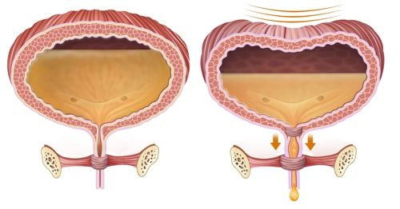
Urinary incontinence
44–57% of the middle-aged female population
risk factors
Aging
pregnancy and childbirth
Vaginal delivery especially Instrumental delivery
Obesity
high-impact exercise
Alcohol use

Slide 15
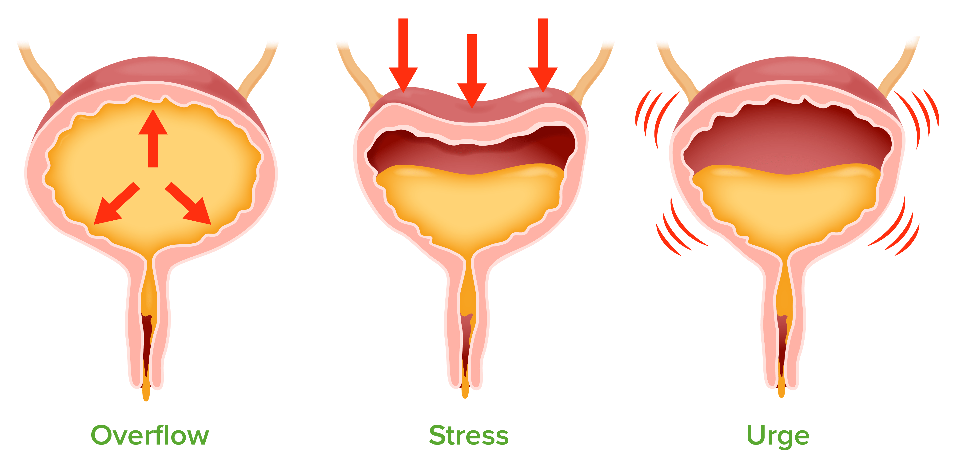
Urinary incontinence
most common type of UI in pregnancy is Stress UI (18–75%)
prevalence of UI decreases after birth to around 30% three months postpartum
UI at three months postpartum predicts UI five years later

Slide 16
management
PFMT has been shown to be effective in preventing pelvic floor dysfunction during and after pregnan
PFMT combined with aerobic exercise reduced the risk of prenatal and postnatal UI up to 50%
In turn, exercise was not therapeutic in women who developed UI during pregnancy, although they experienced a reduction in symptom severity

Slide 17
Postpartum voiding dysfunction
lack of spontaneous micturition 6 h post delivery or removal of foley catheter
0.7- 4% of all deliveries
Risk factors
instrumental delivery
prolonged second stage
regional anaesthesia
trauma to the pudendal nerve, or pelvic floor
increased urine production

Slide 18
management
Intrapartum bladder care
Women who do not spontaneously micturate 6 h following delivery or catheter removal should have the residual volume of urine checked, which can be achieved either via an in out catheter or a bladder scan
Urine culture

Slide 19
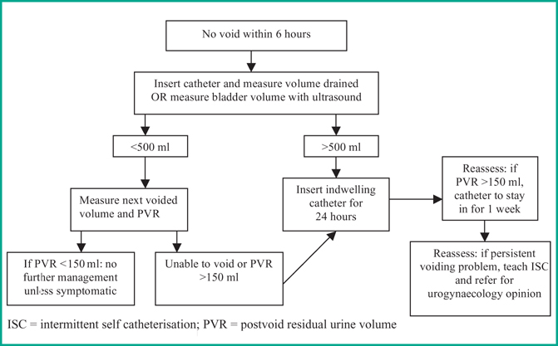

Slide 20


